Slide 1

Analogue years discussion
FMA and MAM 2023
Lead: Dr. Andre KAMGA
Contributors: Hubert KABENGELA, Dr. Pierre KAMSU and Sunshine Gamedze
CDD
ACMAD
14 February 2023

Slide 2
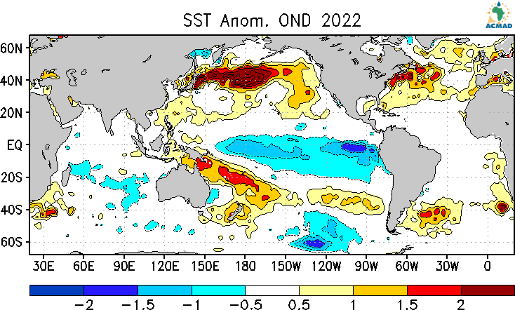
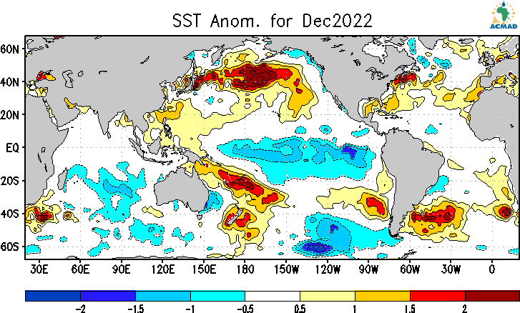
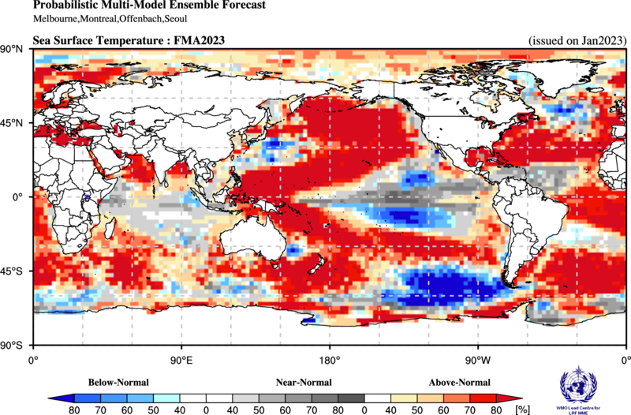
Identification of Analogue Years (1)
OBS
FCST

Slide 3
Identification of Analogue Years (2)
Year | DJF | JFM | FMA | MAM | AMJ | MJJ | JJA | JAS | ASO | SON | OND | NDJ
2000 | -1.7 | -1.4 | -1.1 | -0.8 | -0.7 | -0.6 | -0.6 | -0.5 | -0.5 | -0.6 | -0.7 | -0.7
2001 | -0.7 | -0.5 | -0.4 | -0.3 | -0.3 | -0.1 | -0.1 | -0.1 | -0.2 | -0.3 | -0.3 | -0.3
2002 | -0.1 | 0.0 | 0.1 | 0.2 | 0.4 | 0.7 | 0.8 | 0.9 | 1.0 | 1.2 | 1.3 | 1.1
2003 | 0.9 | 0.6 | 0.4 | 0.0 | -0.3 | -0.2 | 0.1 | 0.2 | 0.3 | 0.3 | 0.4 | 0.4
2004 | 0.4 | 0.3 | 0.2 | 0.2 | 0.2 | 0.3 | 0.5 | 0.6 | 0.7 | 0.7 | 0.7 | 0.7
2005 | 0.6 | 0.6 | 0.4 | 0.4 | 0.3 | 0.1 | -0.1 | -0.1 | -0.1 | -0.3 | -0.6 | -0.8
2006 | -0.9 | -0.8 | -0.6 | -0.4 | -0.1 | 0.0 | 0.1 | 0.3 | 0.5 | 0.8 | 0.9 | 0.9
2007 | 0.7 | 0.2 | -0.1 | -0.3 | -0.4 | -0.5 | -0.6 | -0.8 | -1.1 | -1.3 | -1.5 | -1.6
2008 | -1.6 | -1.5 | -1.3 | -1.0 | -0.8 | -0.6 | -0.4 | -0.2 | -0.2 | -0.4 | -0.6 | -0.7
2009 | -0.8 | -0.8 | -0.6 | -0.3 | 0.0 | 0.3 | 0.5 | 0.6 | 0.7 | 1.0 | 1.4 | 1.6
Year | DJF | JFM | FMA | MAM | AMJ | MJJ | JJA | JAS | ASO | SON | OND | NDJ
2010 | 1.5 | 1.2 | 0.8 | 0.4 | -0.2 | -0.7 | -1.0 | -1.3 | -1.6 | -1.6 | -1.6 | -1.6
2011 | -1.4 | -1.2 | -0.9 | -0.7 | -0.6 | -0.4 | -0.5 | -0.6 | -0.8 | -1.0 | -1.1 | -1.0
2012 | -0.9 | -0.7 | -0.6 | -0.5 | -0.3 | 0.0 | 0.2 | 0.4 | 0.4 | 0.3 | 0.1 | -0.2
2013 | -0.4 | -0.4 | -0.3 | -0.3 | -0.4 | -0.4 | -0.4 | -0.3 | -0.3 | -0.2 | -0.2 | -0.3
2014 | -0.4 | -0.5 | -0.3 | 0.0 | 0.2 | 0.2 | 0.0 | 0.1 | 0.2 | 0.5 | 0.6 | 0.7
2015 | 0.5 | 0.5 | 0.5 | 0.7 | 0.9 | 1.2 | 1.5 | 1.9 | 2.2 | 2.4 | 2.6 | 2.6
2016 | 2.5 | 2.1 | 1.6 | 0.9 | 0.4 | -0.1 | -0.4 | -0.5 | -0.6 | -0.7 | -0.7 | -0.6
2017 | -0.3 | -0.2 | 0.1 | 0.2 | 0.3 | 0.3 | 0.1 | -0.1 | -0.4 | -0.7 | -0.8 | -1.0
2018 | -0.9 | -0.9 | -0.7 | -0.5 | -0.2 | 0.0 | 0.1 | 0.2 | 0.5 | 0.8 | 0.9 | 0.8
2019 | 0.7 | 0.7 | 0.7 | 0.7 | 0.5 | 0.5 | 0.3 | 0.1 | 0.2 | 0.3 | 0.5 | 0.5
Year | DJF | JFM | FMA | MAM | AMJ | MJJ | JJA | JAS | ASO | SON | OND | NDJ
2020 | 0.5 | 0.5 | 0.4 | 0.2 | -0.1 | -0.3 | -0.4 | -0.6 | -0.9 | -1.2 | -1.3 | -1.2
2021 | -1.0 | -0.9 | -0.8 | -0.7 | -0.5 | -0.4 | -0.4 | -0.5 | -0.7 | -0.8 | -1.0 | -1.0
2022 | -1.0 | -0.9 | -1.0 | -1.1 | -1.0 | -0.9 | -0.8 | -0.9 | -1.0 | -1.0 | -0.9 | -0.8
Steps:
Used the current season observed SST value (Table from NCEP)
Looked for previous seasons with almost exact values and pattern
Checked for years with a similar evolution and pattern, but not necessarily the values
Used the predicted ENSO evolution from Statistical and Dynamic models (IRI) to determine future direction
Blue – La Nina
Red– El Nino
Probable years
2001
2006
2012
2021
Identified analogue years – 2001, 2006, 2012, 2021

Slide 4
Forecasted SST evolution
Season | JFM | FMA | MAM | AMJ | MJJ | JJA | JAS | ASO | SON
Average, Dynamical models | -0.444 | -0.169 | 0.102 | 0.344 | 0.586 | 0.798 | 0.91 | 0.908 | 0.907
Average, Statistical models | -0.626 | -0.398 | -0.171 | 0.057 | 0.271 | 0.414 | 0.446 | 0.495 | 0.573
Average, All models | -0.492 | -0.229 | 0.031 | 0.269 | 0.492 | 0.663 | 0.736 | 0.717 | 0.753
Forecasted evolution of SSTs during the coming target seasons indicate a transition from an ENSO negative (La Nina) phase to an ENSO positive (El Nino) phase during the coming target seasons

Slide 5
Other Oceans individually

Slide 6
Indian Ocean analogue years – IOD / DMI
(3-month rolling mean)
https://ds.data.jma.go.jp/tcc/tcc/products/elnino/index/sstindex/base_period_9120/DMI/3rmean
Year | Jan | Feb | Mar | Apr | May | Jun | Jul | Aug | Sep | Oct | Nov | Dec
2000 | -0.03 | 0.24 | 0.39 | 0.32 | 0.1 | 0.1 | 0.1 | 0.11 | -0.13 | -0.33 | -0.35 | -0.09
2001 | 0.2 | 0.41 | 0.28 | 0.03 | -0.18 | -0.35 | -0.36 | -0.42 | -0.38 | -0.22 | -0.14 | -0.08
2002 | -0.12 | -0.23 | -0.3 | -0.43 | -0.38 | -0.38 | -0.34 | -0.19 | 0 | 0.11 | -0.02 | -0.2
2003 | -0.12 | -0.03 | 0.09 | 0.08 | 0.19 | 0.3 | 0.29 | 0.21 | 0.06 | -0.09 | -0.08 | -0.07
2004 | 0.03 | 0.01 | -0.04 | -0.25 | -0.5 | -0.53 | -0.36 | -0.09 | 0.02 | -0.05 | -0.15 | -0.23
2005 | -0.44 | -0.68 | -0.61 | -0.3 | -0.1 | -0.26 | -0.39 | -0.52 | -0.54 | -0.48 | -0.34 | -0.22
2006 | -0.3 | -0.32 | -0.19 | -0.02 | 0.07 | 0.01 | 0.03 | 0.21 | 0.53 | 0.73 | 0.66 | 0.41
2007 | 0.16 | 0.16 | 0.18 | 0.31 | 0.32 | 0.36 | 0.32 | 0.33 | 0.28 | 0.16 | -0.06 | -0.1
2008 | -0.05 | 0.11 | -0.02 | 0.03 | 0.15 | 0.49 | 0.59 | 0.45 | 0.22 | -0.01 | -0.1 | -0.18
2009 | 0 | 0.19 | 0.27 | 0.22 | 0.12 | 0.01 | -0.08 | -0.19 | -0.15 | -0.19 | -0.03 | 0.17
2010 | 0.22 | 0.24 | 0.24 | 0.14 | 0.02 | -0.17 | -0.19 | -0.55 | -0.83 | -0.75 | -0.46 | -0.07
2011 | -0.01 | 0.11 | 0.1 | 0.12 | 0.09 | 0.13 | 0.25 | 0.42 | 0.52 | 0.41 | 0.21 | 0.09
2012 | 0.02 | 0.1 | -0.03 | 0.04 | -0.02 | 0.21 | 0.47 | 0.7 | 0.59 | 0.31 | 0.09 | 0.05
2013 | 0.05 | -0.05 | -0.14 | -0.31 | -0.42 | -0.47 | -0.4 | -0.35 | -0.33 | -0.25 | -0.2 | -0.11
2014 | -0.1 | -0.2 | -0.29 | -0.27 | -0.2 | -0.25 | -0.42 | -0.42 | -0.25 | -0.08 | -0.09 | -0.26
2015 | -0.37 | -0.32 | -0.17 | 0.09 | 0.24 | 0.32 | 0.35 | 0.55 | 0.72 | 0.7 | 0.42 | 0.02
2016 | -0.2 | -0.24 | -0.13 | -0.18 | -0.39 | -0.72 | -0.82 | -0.98 | -0.86 | -0.74 | -0.39 | -0.16
2017 | 0.02 | 0.13 | 0.29 | 0.34 | 0.37 | 0.32 | 0.41 | 0.38 | 0.23 | 0.04 | -0.12 | -0.07
2018 | 0.04 | 0.05 | 0.07 | -0.04 | -0.04 | -0.01 | 0.07 | 0.36 | 0.42 | 0.47 | 0.31 | 0.21
2019 | -0.04 | -0.15 | -0.17 | 0.14 | 0.38 | 0.6 | 0.77 | 0.98 | 1.46 | 1.68 | 1.49 | 0.84
2020 | 0.2 | -0.07 | -0.13 | 0.06 | 0.34 | 0.46 | 0.14 | -0.21 | -0.3 | -0.17 | 0.01 | 0.05
2021 | 0.12 | 0.07 | 0.16 | 0.02 | -0.14 | -0.5 | -0.48 | -0.4 | -0.37 | -0.38 | -0.35 | -0.26
2022 | -0.31 | -0.3 | -0.27 | -0.22 | -0.36 | -0.6 | -0.78 | -0.92 | -0.94 | -0.75 | 99.9 | 99.9
Steps:
Used the current season observed SST value (Table from Jamstec)
Looked for previous seasons with almost exact values and pattern
Checked for years with a similar evolution and pattern, but not necessarily the values
Used the predicted IOD evolution from GPCs and ACMAD SSTs Boxes to determine future evolution
Probable years
2002
2006
2011
2017

Slide 7
Indian Ocean analogue years - SIOD
Steps:
Used the current season observed SST value (Table from Jamstec)
Looked for previous seasons with almost exact values and pattern
Checked for years with a similar evolution and pattern, but not necessarily the values
Used the predicted IOD evolution from GPCs and ACMAD SSTs Boxes to determine future evolution
Year | Jan | Feb | Mar | Apr | May | Jun | Jul | Aug | Sep | Oct | Nov | Dec
2000 | -1.61 | -0.59 | 0.71 | 1.08 | 0.53 | 0.09 | -0.31 | -0.41 | -0.74 | -0.54 | -0.50 | 0.04
2001 | -0.28 | 0.63 | 1.70 | 0.80 | 0.42 | -0.48 | -1.10 | -1.08 | -0.22 | -0.20 | -0.22 | -0.85
2002 | -1.57 | -0.74 | -0.91 | -1.48 | -1.11 | -0.88 | -0.65 | -0.50 | -0.04 | -0.44 | -0.16 | -1.06
2003 | -0.93 | -0.47 | 0.15 | 0.11 | 0.11 | -0.13 | -0.92 | -0.78 | -0.15 | -0.59 | 0.10 | 0.45
2004 | 0.09 | -0.16 | 0.18 | 0.92 | 0.30 | -0.48 | -0.04 | 0.61 | 0.75 | -0.06 | 0.80 | 0.38
2005 | 0.76 | 0.35 | 0.20 | -0.40 | -0.04 | -0.06 | 0.00 | -0.19 | -0.33 | 0.48 | 0.12 | 0.37
2006 | 0.82 | 2.30 | 2.02 | 1.44 | 0.48 | 0.64 | -0.29 | -0.08 | -0.21 | -0.82 | 0.54 | 1.00
2007 | 1.17 | 0.89 | 1.17 | 0.88 | 0.64 | 0.20 | 0.24 | -0.11 | -0.08 | -0.57 | 0.10 | -0.03
2008 | 1.01 | 0.80 | 0.88 | 0.32 | 0.04 | -0.47 | -0.60 | -0.31 | -0.41 | -0.10 | 0.46 | 0.70
2009 | -0.11 | -0.32 | -0.08 | 0.12 | -0.33 | -0.25 | -0.09 | -0.50 | 0.11 | -0.61 | -0.62 | -0.46
2010 | -0.16 | -1.09 | -0.95 | -0.10 | 0.43 | 0.60 | 0.37 | -0.26 | 0.02 | -0.51 | 0.34 | 1.25
2011 | 1.21 | 0.74 | 0.56 | 1.15 | 0.56 | 0.12 | -0.03 | -0.74 | -0.82 | -1.28 | -0.63 | -0.91
2012 | -0.68 | -0.64 | -0.47 | -0.21 | 0.12 | -0.62 | -0.34 | 0.07 | -0.46 | -0.45 | -1.33 | -1.71
2013 | -0.91 | -0.25 | 0.08 | -0.08 | -0.23 | -0.50 | -0.46 | -0.77 | 0.11 | -0.72 | -1.24 | -1.17
2014 | -1.20 | -0.04 | 0.83 | -0.42 | 0.03 | -0.84 | -0.55 | -0.87 | -0.85 | -1.05 | -0.64 | 0.58
2015 | -0.25 | -0.20 | -0.99 | 0.18 | -0.06 | -0.28 | -0.48 | -0.28 | -0.34 | -0.52 | -0.32 | -0.32
2016 | -0.07 | -0.78 | -0.57 | -0.87 | -0.63 | -1.09 | -0.91 | -0.78 | -0.63 | -0.06 | -0.01 | 0.71
2017 | 2.14 | 1.35 | 1.63 | 1.78 | 0.26 | 0.58 | 0.43 | 0.26 | 0.27 | 0.57 | 0.51 | 0.56
2018 | 0.59 | -0.09 | 0.56 | 0.56 | -0.01 | 0.08 | -0.32 | -0.30 | 0.16 | 0.40 | 0.92 | 1.42
2019 | 1.20 | 0.62 | 0.83 | 1.39 | 0.40 | -0.25 | -0.26 | -0.49 | -1.35 | -1.38 | -0.88 | -2.90
2020 | -1.34 | -1.12 | -1.69 | -0.77 | -0.98 | -1.25 | -1.51 | -1.45 | -1.22 | -1.53 | -1.91 | -1.04
2021 | 0.67 | 1.81 | 0.61 | 0.36 | 0.43 | 0.09 | 0.14 | -0.25 | -0.33 | 0.05 | 1.29 | 0.20
2022 | -1.32 | -0.67 | 0.27 | 0.27 | 0.54 | -0.38 | -0.88 | -0.35 | 0.27 | 0.00 | 0.80
Probable years
2005*
2007
2009
2018
2019
2022

Slide 9
Atlantic analogue years (TNA)
https://psl.noaa.gov/data/correlation/tna.data
Areas affected by TNA in the Continent:
West Africa
Year | Jan | Feb | Mar | Apr | May | Jun | Jul | Aug | Sep | Oct | Nov | Dec
2000 | -0.18 | -0.1 | 0.06 | -0.01 | -0.06 | -0.16 | 0.01 | 0.15 | 0.02 | 0 | -0.12 | -0.19
2001 | -0.13 | -0.15 | 0.15 | 0.05 | 0.06 | 0.24 | 0.3 | 0.34 | 0.51 | 0.48 | 0.62 | 0.66
2002 | 0.78 | 0.53 | 0.37 | -0.02 | -0.19 | -0.13 | -0.06 | -0.05 | 0.07 | 0.36 | 0.22 | 0.2
2003 | 0.27 | 0 | 0.04 | 0 | 0.06 | 0.22 | 0.36 | 0.59 | 0.66 | 0.8 | 0.48 | 0.49
2004 | 0.5 | 0.51 | 0.36 | 0.46 | 0.17 | 0.27 | 0.46 | 0.68 | 0.59 | 0.62 | 0.63 | 0.53
2005 | 0.46 | 0.38 | 0.68 | 0.81 | 1.01 | 0.92 | 0.84 | 0.74 | 0.73 | 0.54 | 0.4 | 0.55
2006 | 0.41 | 0.19 | 0.18 | 0.41 | 0.43 | 0.52 | 0.36 | 0.53 | 0.69 | 0.74 | 0.71 | 0.47
2007 | 0.46 | 0.56 | 0.33 | 0.4 | 0.21 | 0.16 | 0.09 | 0.01 | 0.11 | 0.24 | 0.24 | 0.09
2008 | 0.14 | 0.18 | 0.27 | 0.09 | 0.28 | 0.39 | 0.45 | 0.45 | 0.57 | 0.43 | 0.27 | 0.26
2009 | 0.07 | -0.37 | -0.34 | -0.31 | -0.23 | 0.05 | 0.45 | 0.41 | 0.35 | 0.63 | 0.51 | 0.54
2010 | 0.8 | 1.07 | 1.27 | 1.4 | 1.35 | 1.11 | 1.01 | 0.97 | 0.75 | 0.77 | 0.7 | 0.96
2011 | 0.97 | 0.53 | 0.41 | 0.33 | 0.41 | 0.59 | 0.43 | 0.49 | 0.36 | 0.44 | 0.21 | 0.23
2012 | 0.16 | -0.02 | -0.26 | -0.17 | 0.09 | 0.31 | 0.3 | 0.52 | 0.72 | 0.78 | 0.75 | 0.55
2013 | 0.44 | 0.4 | 0.7 | 0.53 | 0.64 | 0.32 | 0.34 | 0.56 | 0.61 | 0.66 | 0.32 | 0.27
2014 | 0.13 | -0.08 | -0.35 | -0.21 | -0.06 | -0.05 | 0.14 | 0.23 | 0.51 | 0.56 | 0.35 | 0.34
2015 | 0.17 | 0.11 | -0.11 | -0.24 | 0.08 | -0.07 | 0.16 | 0.43 | 0.72 | 0.93 | 0.49 | 0.42
2016 | 0.5 | 0.45 | 0.39 | 0.32 | 0.38 | 0.39 | 0.37 | 0.49 | 0.39 | 0.55 | 0.46 | 0.52
2017 | 0.49 | 0.23 | 0.13 | 0.47 | 0.58 | 0.6 | 0.6 | 0.67 | 0.52 | 0.45 | 0.53 | 0.54
2018 | 0.28 | -0.09 | 0.02 | -0.17 | -0.4 | -0.48 | -0.21 | 0.01 | 0.33 | 0.29 | -0.01 | -0.04
2019 | 0.08 | 0.14 | 0.01 | -0.02 | 0.12 | 0.3 | 0.37 | 0.42 | 0.57 | 0.44 | 0.26 | 0.25
2020 | 0.25 | 0.5 | 0.73 | 0.62 | 0.52 | 0.72 | 0.65 | 0.59 | 0.52 | 0.61 | 0.39 | 0.46
2021 | 0.52 | 0.41 | 0.14 | 0.32 | 0.24 | 0.14 | 0.25 | 0.26 | 0.54 | 0.46 | 0.42 | 0.46
2022 | 0.61 | 0.57 | 0.08 | 0.04 | 0.34 | 0.48 | 0.32 | 0.47 | 0.62 | 0.5 | 0.33 | 0.47
2023 | 0.32 | -99.99 | -99.99 | -99.99 | -99.99 | -99.99 | -99.99 | -99.99 | -99.99 | -99.99 | -99.99 | -99.99
Steps:
Used the current season observed SST value (Table from PSL)
Looked for previous seasons with almost exact values and pattern
Checked for years with a similar evolution and pattern, but not necessarily the values
Used the predicted TNA evolution from ??? to determine future direction
Probable years
2003
2006*
2013
2018
2020

Slide 10
Atlantic analogue years (TSA)
https://psl.noaa.gov/data/correlation/tsa.data
Year | Jan | Feb | Mar | Apr | May | Jun | Jul | Aug | Sep | Oct | Nov | Dec
2000 | 0.21 | 0.39 | 0.4 | 0.37 | 0.29 | 0.2 | 0.15 | 0.2 | 0.02 | 0.1 | 0.07 | -0.01
2001 | 0.16 | 0.17 | 0.29 | 0.38 | 0.47 | 0.36 | 0.15 | 0.14 | 0.11 | 0.2 | 0.16 | 0.01
2002 | 0.14 | -0.06 | 0.29 | 0.31 | 0.49 | 0.33 | 0.47 | 0.01 | -0.08 | 0.14 | -0.07 | 0.35
2003 | 0.56 | 0.57 | 0.63 | 0.42 | 0.37 | 0.1 | 0.4 | 0.49 | 0.49 | 0.53 | 0.55 | 0.56
2004 | 0.41 | 0.22 | -0.01 | -0.26 | -0.12 | -0.08 | 0.08 | 0.22 | 0.33 | 0.14 | 0.24 | 0.43
2005 | 0.61 | 0.49 | 0.61 | 0.29 | -0.06 | -0.26 | -0.32 | 0.01 | -0.09 | 0 | -0.07 | -0.02
2006 | 0.04 | 0.23 | 0.41 | 0.31 | 0.24 | 0.41 | 0.3 | 0.33 | 0.27 | 0.23 | 0.08 | 0.32
2007 | 0.24 | 0.21 | 0.04 | 0.24 | 0.28 | 0.43 | 0.23 | 0.15 | 0.27 | 0.11 | 0.1 | 0.2
2008 | 0.19 | 0.36 | 0.6 | 0.64 | 0.82 | 0.7 | 0.66 | 0.51 | 0.28 | 0.27 | 0.31 | 0.41
2009 | 0.45 | 0.35 | 0.54 | 0.52 | 0.79 | 0.59 | 0.39 | 0.24 | 0.19 | 0.45 | 0.3 | 0.7
2010 | 0.79 | 0.68 | 0.89 | 0.68 | 0.62 | 0.85 | 0.6 | 0.48 | 0.23 | 0.43 | 0.4 | 0.41
2011 | 0.45 | 0.59 | 0.72 | 0.49 | 0.3 | 0.2 | 0.27 | 0.2 | 0.24 | 0.28 | -0.05 | -0.48
2012 | -0.32 | -0.51 | -0.08 | -0.33 | -0.04 | 0.04 | -0.03 | -0.08 | 0.02 | 0.03 | 0.03 | 0.18
2013 | 0.39 | 0.25 | 0.26 | 0.35 | 0.48 | 0.28 | 0.23 | 0.25 | 0.03 | 0.04 | -0.07 | 0.11
2014 | 0.11 | 0.22 | 0.22 | 0.23 | 0.48 | 0.47 | 0.17 | 0.24 | 0.26 | 0.16 | -0.32 | -0.12
2015 | 0.43 | 0.42 | 0.23 | 0.36 | 0.46 | 0.38 | 0.07 | -0.11 | -0.04 | 0.28 | 0.37 | 0.7
2016 | 0.81 | 0.59 | 0.6 | 0.39 | 0.35 | 0.68 | 0.63 | 0.52 | 0.26 | 0.46 | 0.28 | 0.67
2017 | 0.58 | 0.09 | 0.29 | 0.4 | 0.47 | 0.57 | 0.35 | 0.59 | 0.27 | 0.42 | 0.2 | 0.17
2018 | 0.62 | -0.01 | 0.17 | 0.28 | 0.28 | 0.46 | 0.38 | 0.41 | 0.36 | 0.53 | 0.39 | 0.66
2019 | 0.75 | 0.68 | 1.02 | 0.65 | 0.65 | 0.58 | 0.5 | 0.41 | 0.48 | 0.47 | 1.06 | 1.06
2020 | 1.28 | 0.84 | 0.66 | 0.72 | 0.88 | 0.6 | 0.55 | 0.5 | 0.24 | 0.39 | 0.12 | -0.11
2021 | 0.21 | -0.06 | 0.14 | 0.37 | 0.76 | 0.89 | 1.11 | 0.92 | 0.58 | 0.65 | 0.5 | 0.26
2022 | 0.47 | 0.73 | 0.57 | 0.46 | 0.36 | 0.61 | 0.34 | 0.38 | 0.35 | 0.52 | 0.46 | -99.99
Steps:
Used the current season observed SST value (Table from PSL)
Looked for previous seasons with almost exact values and pattern
Checked for years with a similar evolution and pattern, but not necessarily the values
Used the predicted TSA evolution from ACMAD SSTs boxes to determine future evolution
Probable years
2004
2011
2016
2019
2022

Slide 11
Atlantic analogue years (Benguela)
Steps:
Used the current season observed SST value (Table from PSL)
Looked for previous seasons with almost exact values and pattern
Checked for years with a similar evolution and pattern, but not necessarily the values
Used the predicted TSA evolution from ACMAD SSTs boxes to determine future evolution
Year | Jan | Feb | Mar | Apr | May | Jun | Jul | Aug | Sep | Oct | Nov | Dec
2000 | 0.96 | 1.04 | 0.63 | 0.89 | 0.70 | 0.75 | 0.95 | 1.00 | 0.30 | 0.16 | 0.30 | 0.44
2001 | 0.92 | 0.66 | 1.39 | 1.80 | 1.77 | 1.18 | -0.04 | -0.03 | -0.91 | -0.59 | -0.08 | -0.24
2002 | -0.59 | -0.91 | 0.58 | 1.13 | 0.96 | 0.45 | -0.14 | 0.02 | -0.65 | -0.36 | -0.76 | -0.34
2003 | 0.18 | 1.22 | 1.02 | 0.11 | 0.08 | -0.36 | 1.12 | 0.76 | 0.63 | 0.66 | 0.99 | 1.30
2004 | 0.53 | -0.06 | -0.77 | -1.40 | -0.20 | 0.27 | 0.49 | 0.59 | 0.31 | 0.30 | 0.82 | 0.93
2005 | 1.12 | 1.51 | 0.94 | -0.38 | -1.52 | -1.26 | -0.38 | 0.17 | 0.27 | 0.32 | 0.60 | 0.32
2006 | 0.92 | 0.78 | 1.47 | 1.37 | 0.90 | 1.03 | 0.66 | 0.32 | 0.25 | 0.06 | 0.40 | 0.53
2007 | 1.11 | 0.99 | 1.36 | 1.09 | 1.10 | 0.73 | 0.81 | 0.65 | 0.47 | 0.26 | 0.65 | 0.27
2008 | 0.44 | 1.16 | 1.10 | 1.07 | 1.02 | 0.24 | 0.40 | 1.08 | 0.64 | 0.35 | 0.01 | 1.15
2009 | 1.04 | 0.94 | 0.89 | 1.07 | 0.71 | -0.20 | 0.38 | 0.50 | 0.73 | 0.21 | 0.55 | 0.93
2010 | 1.12 | 0.19 | 0.14 | 0.00 | -0.34 | 0.44 | 0.30 | 0.59 | 0.68 | 0.42 | 0.76 | 1.53
2011 | 2.39 | 2.47 | 2.12 | 2.17 | 0.85 | 0.11 | -0.15 | -0.04 | 0.15 | 0.04 | -0.13 | -0.73
2012 | -0.36 | -0.23 | 0.15 | 0.11 | 0.27 | 0.27 | 0.11 | 0.07 | -0.15 | -0.20 | 1.17 | 1.56
2013 | 1.17 | 0.44 | 0.25 | -0.66 | 0.51 | 0.04 | -0.31 | 0.10 | -0.03 | 0.08 | 0.14 | 0.81
2014 | 0.86 | 0.78 | 0.50 | 0.35 | 1.25 | 0.39 | -0.59 | -0.06 | -0.13 | 0.02 | 0.58 | 0.76
2015 | 1.01 | -0.01 | 0.05 | 0.33 | 1.03 | -0.44 | -0.63 | -0.41 | -0.34 | 0.44 | 1.33 | 1.23
2016 | 2.05 | 1.82 | 1.57 | 0.44 | 0.25 | 0.91 | 1.13 | 0.85 | 0.17 | 0.40 | 0.94 | 1.37
2017 | 1.19 | 0.11 | 0.44 | 1.06 | 0.78 | 0.89 | 0.12 | 0.18 | 0.26 | 0.53 | 0.35 | -0.27
2018 | 0.29 | 0.72 | 0.32 | 1.32 | 1.01 | 0.57 | 0.30 | -0.43 | -0.97 | 0.29 | 0.76 | 0.31
2019 | 0.48 | 0.44 | 0.59 | 0.12 | -0.41 | 0.13 | 0.26 | 0.23 | 0.91 | 0.82 | 1.91 | 2.18
2020 | 1.97 | 0.79 | 0.91 | 0.04 | 0.79 | 1.33 | 1.00 | 1.38 | 0.39 | -0.10 | 0.39 | 0.30
2021 | 1.13 | 1.03 | 0.06 | 1.34 | 1.93 | 1.77 | 1.55 | 1.67 | 0.15 | 0.52 | 1.57 | 0.42
2022 | 1.01 | 1.43 | 0.61 | -0.10 | 0.03 | 0.37 | 0.16 | 0.39 | 0.43 | 1.16 | 1.08
Probable years
2008
2011
2016
2020
2022

Slide 12
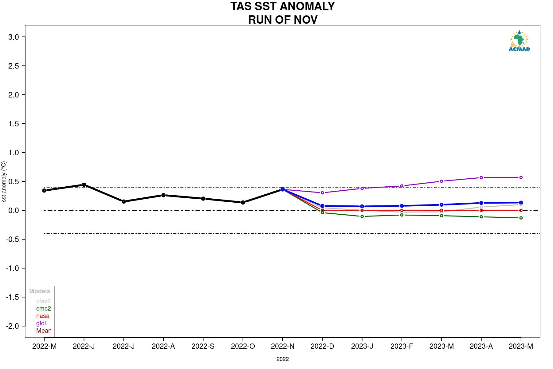

Slide 13
Other Oceans with ENSO phase

Slide 14
Indian Ocean analogue years
https://ds.data.jma.go.jp/tcc/tcc/products/elnino/index/sstindex/base_period_9120/DMI/3rmean
(3-month rolling mean)
Year | Jan | Feb | Mar | Apr | May | Jun | Jul | Aug | Sep | Oct | Nov | Dec
2000 | -0.03 | 0.24 | 0.39 | 0.32 | 0.1 | 0.1 | 0.1 | 0.11 | -0.13 | -0.33 | -0.35 | -0.09
2001 | 0.2 | 0.41 | 0.28 | 0.03 | -0.18 | -0.35 | -0.36 | -0.42 | -0.38 | -0.22 | -0.14 | -0.08
2002 | -0.12 | -0.23 | -0.3 | -0.43 | -0.38 | -0.38 | -0.34 | -0.19 | 0 | 0.11 | -0.02 | -0.2
2003 | -0.12 | -0.03 | 0.09 | 0.08 | 0.19 | 0.3 | 0.29 | 0.21 | 0.06 | -0.09 | -0.08 | -0.07
2004 | 0.03 | 0.01 | -0.04 | -0.25 | -0.5 | -0.53 | -0.36 | -0.09 | 0.02 | -0.05 | -0.15 | -0.23
2005 | -0.44 | -0.68 | -0.61 | -0.3 | -0.1 | -0.26 | -0.39 | -0.52 | -0.54 | -0.48 | -0.34 | -0.22
2006 | -0.3 | -0.32 | -0.19 | -0.02 | 0.07 | 0.01 | 0.03 | 0.21 | 0.53 | 0.73 | 0.66 | 0.41
2007 | 0.16 | 0.16 | 0.18 | 0.31 | 0.32 | 0.36 | 0.32 | 0.33 | 0.28 | 0.16 | -0.06 | -0.1
2008 | -0.05 | 0.11 | -0.02 | 0.03 | 0.15 | 0.49 | 0.59 | 0.45 | 0.22 | -0.01 | -0.1 | -0.18
2009 | 0 | 0.19 | 0.27 | 0.22 | 0.12 | 0.01 | -0.08 | -0.19 | -0.15 | -0.19 | -0.03 | 0.17
2010 | 0.22 | 0.24 | 0.24 | 0.14 | 0.02 | -0.17 | -0.19 | -0.55 | -0.83 | -0.75 | -0.46 | -0.07
2011 | -0.01 | 0.11 | 0.1 | 0.12 | 0.09 | 0.13 | 0.25 | 0.42 | 0.52 | 0.41 | 0.21 | 0.09
2012 | 0.02 | 0.1 | -0.03 | 0.04 | -0.02 | 0.21 | 0.47 | 0.7 | 0.59 | 0.31 | 0.09 | 0.05
2013 | 0.05 | -0.05 | -0.14 | -0.31 | -0.42 | -0.47 | -0.4 | -0.35 | -0.33 | -0.25 | -0.2 | -0.11
2014 | -0.1 | -0.2 | -0.29 | -0.27 | -0.2 | -0.25 | -0.42 | -0.42 | -0.25 | -0.08 | -0.09 | -0.26
2015 | -0.37 | -0.32 | -0.17 | 0.09 | 0.24 | 0.32 | 0.35 | 0.55 | 0.72 | 0.7 | 0.42 | 0.02
2016 | -0.2 | -0.24 | -0.13 | -0.18 | -0.39 | -0.72 | -0.82 | -0.98 | -0.86 | -0.74 | -0.39 | -0.16
2017 | 0.02 | 0.13 | 0.29 | 0.34 | 0.37 | 0.32 | 0.41 | 0.38 | 0.23 | 0.04 | -0.12 | -0.07
2018 | 0.04 | 0.05 | 0.07 | -0.04 | -0.04 | -0.01 | 0.07 | 0.36 | 0.42 | 0.47 | 0.31 | 0.21
2019 | -0.04 | -0.15 | -0.17 | 0.14 | 0.38 | 0.6 | 0.77 | 0.98 | 1.46 | 1.68 | 1.49 | 0.84
2020 | 0.2 | -0.07 | -0.13 | 0.06 | 0.34 | 0.46 | 0.14 | -0.21 | -0.3 | -0.17 | 0.01 | 0.05
2021 | 0.12 | 0.07 | 0.16 | 0.02 | -0.14 | -0.5 | -0.48 | -0.4 | -0.37 | -0.38 | -0.35 | -0.26
2022 | -0.31 | -0.3 | -0.27 | -0.22 | -0.36 | -0.6 | -0.78 | -0.92 | -0.94 | -0.75 | 99.9 | 99.9
Steps:
Use the current season observed SST value (Table from Jamstec)
Look for previous seasons with almost exact values and pattern
Check for years with a similar evolution and pattern, but not necessarily the values
Use the predicted IOD evolution from ??? to determine future direction
ENSO
Probable years
2001
2009
2012
2021
2022
Probable years
2002
2006
2011
2017

Slide 15
Atlantic analogue years (TNA)
https://psl.noaa.gov/data/correlation/tna.data
Areas affected by TNA in the Continent:
West Africa
Year | Jan | Feb | Mar | Apr | May | Jun | Jul | Aug | Sep | Oct | Nov | Dec
2000 | -0.18 | -0.1 | 0.06 | -0.01 | -0.06 | -0.16 | 0.01 | 0.15 | 0.02 | 0 | -0.12 | -0.19
2001 | -0.13 | -0.15 | 0.15 | 0.05 | 0.06 | 0.24 | 0.3 | 0.34 | 0.51 | 0.48 | 0.62 | 0.66
2002 | 0.78 | 0.53 | 0.37 | -0.02 | -0.19 | -0.13 | -0.06 | -0.05 | 0.07 | 0.36 | 0.22 | 0.2
2003 | 0.27 | 0 | 0.04 | 0 | 0.06 | 0.22 | 0.36 | 0.59 | 0.66 | 0.8 | 0.48 | 0.49
2004 | 0.5 | 0.51 | 0.36 | 0.46 | 0.17 | 0.27 | 0.46 | 0.68 | 0.59 | 0.62 | 0.63 | 0.53
2005 | 0.46 | 0.38 | 0.68 | 0.81 | 1.01 | 0.92 | 0.84 | 0.74 | 0.73 | 0.54 | 0.4 | 0.55
2006 | 0.41 | 0.19 | 0.18 | 0.41 | 0.43 | 0.52 | 0.36 | 0.53 | 0.69 | 0.74 | 0.71 | 0.47
2007 | 0.46 | 0.56 | 0.33 | 0.4 | 0.21 | 0.16 | 0.09 | 0.01 | 0.11 | 0.24 | 0.24 | 0.09
2008 | 0.14 | 0.18 | 0.27 | 0.09 | 0.28 | 0.39 | 0.45 | 0.45 | 0.57 | 0.43 | 0.27 | 0.26
2009 | 0.07 | -0.37 | -0.34 | -0.31 | -0.23 | 0.05 | 0.45 | 0.41 | 0.35 | 0.63 | 0.51 | 0.54
2010 | 0.8 | 1.07 | 1.27 | 1.4 | 1.35 | 1.11 | 1.01 | 0.97 | 0.75 | 0.77 | 0.7 | 0.96
2011 | 0.97 | 0.53 | 0.41 | 0.33 | 0.41 | 0.59 | 0.43 | 0.49 | 0.36 | 0.44 | 0.21 | 0.23
2012 | 0.16 | -0.02 | -0.26 | -0.17 | 0.09 | 0.31 | 0.3 | 0.52 | 0.72 | 0.78 | 0.75 | 0.55
2013 | 0.44 | 0.4 | 0.7 | 0.53 | 0.64 | 0.32 | 0.34 | 0.56 | 0.61 | 0.66 | 0.32 | 0.27
2014 | 0.13 | -0.08 | -0.35 | -0.21 | -0.06 | -0.05 | 0.14 | 0.23 | 0.51 | 0.56 | 0.35 | 0.34
2015 | 0.17 | 0.11 | -0.11 | -0.24 | 0.08 | -0.07 | 0.16 | 0.43 | 0.72 | 0.93 | 0.49 | 0.42
2016 | 0.5 | 0.45 | 0.39 | 0.32 | 0.38 | 0.39 | 0.37 | 0.49 | 0.39 | 0.55 | 0.46 | 0.52
2017 | 0.49 | 0.23 | 0.13 | 0.47 | 0.58 | 0.6 | 0.6 | 0.67 | 0.52 | 0.45 | 0.53 | 0.54
2018 | 0.28 | -0.09 | 0.02 | -0.17 | -0.4 | -0.48 | -0.21 | 0.01 | 0.33 | 0.29 | -0.01 | -0.04
2019 | 0.08 | 0.14 | 0.01 | -0.02 | 0.12 | 0.3 | 0.37 | 0.42 | 0.57 | 0.44 | 0.26 | 0.25
2020 | 0.25 | 0.5 | 0.73 | 0.62 | 0.52 | 0.72 | 0.65 | 0.59 | 0.52 | 0.61 | 0.39 | 0.46
2021 | 0.52 | 0.41 | 0.14 | 0.32 | 0.24 | 0.14 | 0.25 | 0.26 | 0.54 | 0.46 | 0.42 | 0.46
2022 | 0.61 | 0.57 | 0.08 | 0.04 | 0.34 | 0.48 | 0.32 | 0.47 | 0.56 | -99.99 | -99.99 | -99.99
Steps:
Use the current season observed SST value (Table from PSL)
Look for previous seasons with almost exact values and pattern
Check for years with a similar evolution and pattern, but not necessarily the values
Use the predicted TNA evolution from ??? to determine future direction
ENSO
Probable years
2001
2009
2012
2021
2022
Probable years
2004
2011
2019
2022

Slide 16
Atlantic analogue years (TSA)
https://psl.noaa.gov/data/correlation/tsa.data
Year | Jan | Feb | Mar | Apr | May | Jun | Jul | Aug | Sep | Oct | Nov | Dec
2000 | 0.21 | 0.39 | 0.4 | 0.37 | 0.29 | 0.2 | 0.15 | 0.2 | 0.02 | 0.1 | 0.07 | -0.01
2001 | 0.16 | 0.17 | 0.29 | 0.38 | 0.47 | 0.36 | 0.15 | 0.14 | 0.11 | 0.2 | 0.16 | 0.01
2002 | 0.14 | -0.06 | 0.29 | 0.31 | 0.49 | 0.33 | 0.47 | 0.01 | -0.08 | 0.14 | -0.07 | 0.35
2003 | 0.56 | 0.57 | 0.63 | 0.42 | 0.37 | 0.1 | 0.4 | 0.49 | 0.49 | 0.53 | 0.55 | 0.56
2004 | 0.41 | 0.22 | -0.01 | -0.26 | -0.12 | -0.08 | 0.08 | 0.22 | 0.33 | 0.14 | 0.24 | 0.43
2005 | 0.61 | 0.49 | 0.61 | 0.29 | -0.06 | -0.26 | -0.32 | 0.01 | -0.09 | 0 | -0.07 | -0.02
2006 | 0.04 | 0.23 | 0.41 | 0.31 | 0.24 | 0.41 | 0.3 | 0.33 | 0.27 | 0.23 | 0.08 | 0.32
2007 | 0.24 | 0.21 | 0.04 | 0.24 | 0.28 | 0.43 | 0.23 | 0.15 | 0.27 | 0.11 | 0.1 | 0.2
2008 | 0.19 | 0.36 | 0.6 | 0.64 | 0.82 | 0.7 | 0.66 | 0.51 | 0.28 | 0.27 | 0.31 | 0.41
2009 | 0.45 | 0.35 | 0.54 | 0.52 | 0.79 | 0.59 | 0.39 | 0.24 | 0.19 | 0.45 | 0.3 | 0.7
2010 | 0.79 | 0.68 | 0.89 | 0.68 | 0.62 | 0.85 | 0.6 | 0.48 | 0.23 | 0.43 | 0.4 | 0.41
2011 | 0.45 | 0.59 | 0.72 | 0.49 | 0.3 | 0.2 | 0.27 | 0.2 | 0.24 | 0.28 | -0.05 | -0.48
2012 | -0.32 | -0.51 | -0.08 | -0.33 | -0.04 | 0.04 | -0.03 | -0.08 | 0.02 | 0.03 | 0.03 | 0.18
2013 | 0.39 | 0.25 | 0.26 | 0.35 | 0.48 | 0.28 | 0.23 | 0.25 | 0.03 | 0.04 | -0.07 | 0.11
2014 | 0.11 | 0.22 | 0.22 | 0.23 | 0.48 | 0.47 | 0.17 | 0.24 | 0.26 | 0.16 | -0.32 | -0.12
2015 | 0.43 | 0.42 | 0.23 | 0.36 | 0.46 | 0.38 | 0.07 | -0.11 | -0.04 | 0.28 | 0.37 | 0.7
2016 | 0.81 | 0.59 | 0.6 | 0.39 | 0.35 | 0.68 | 0.63 | 0.52 | 0.26 | 0.46 | 0.28 | 0.67
2017 | 0.58 | 0.09 | 0.29 | 0.4 | 0.47 | 0.57 | 0.35 | 0.59 | 0.27 | 0.42 | 0.2 | 0.17
2018 | 0.62 | -0.01 | 0.17 | 0.28 | 0.28 | 0.46 | 0.38 | 0.41 | 0.36 | 0.53 | 0.39 | 0.66
2019 | 0.75 | 0.68 | 1.02 | 0.65 | 0.65 | 0.58 | 0.5 | 0.41 | 0.48 | 0.47 | 1.06 | 1.06
2020 | 1.28 | 0.84 | 0.66 | 0.72 | 0.88 | 0.6 | 0.55 | 0.5 | 0.24 | 0.39 | 0.12 | -0.11
2021 | 0.21 | -0.06 | 0.14 | 0.37 | 0.76 | 0.89 | 1.11 | 0.92 | 0.58 | 0.65 | 0.5 | 0.26
2022 | 0.47 | 0.73 | 0.57 | 0.46 | 0.36 | 0.61 | 0.34 | 0.38 | 0.35 | 0.52 | 0.46 | -99.99
Steps:
Use the current season observed SST value (Table from PSL)
Look for previous seasons with almost exact values and pattern
Check for years with a similar evolution and pattern, but not necessarily the values
Use the predicted TSA evolution from ??? to determine future direction
Probable years
2004*
2011**
2019
2022
ENSO
Probable years
2001*
2009**
2012
2022**

Slide 17
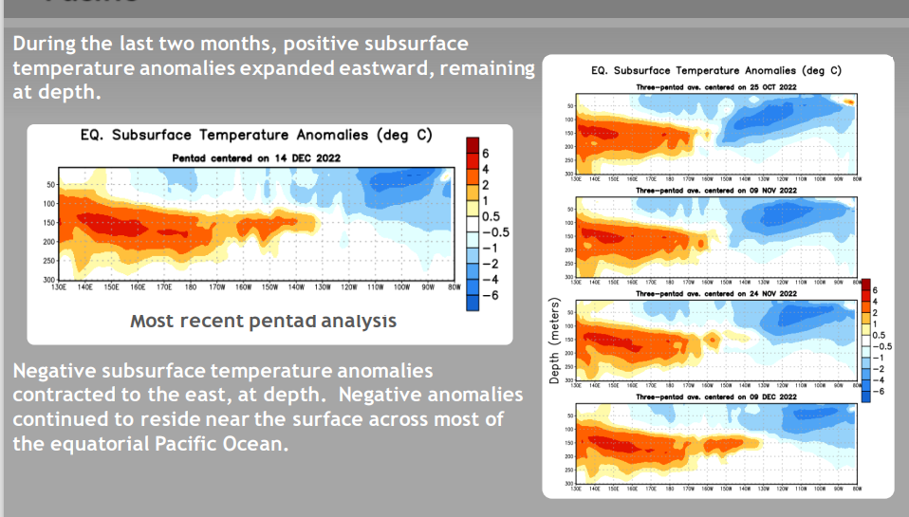

Slide 18
Summary
Based on the current state of the ENSO index for SON and the projected index from JFMA 2023 coupled with TSA current and projected index we arrived at the following:
  Three identical analogues years (2009, 2011 and 2022)
  Alternative analogues years (2001 and 2004)
We are working on inclusion of SIOD data into the process.

Slide 19
Other Oceans

Slide 20
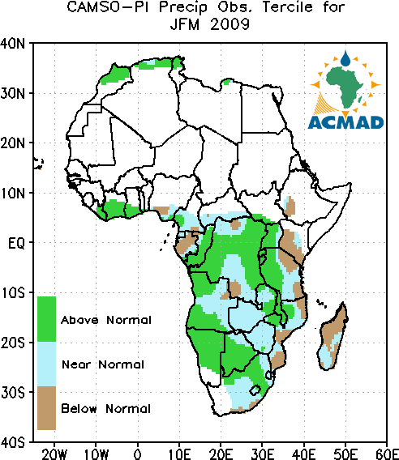
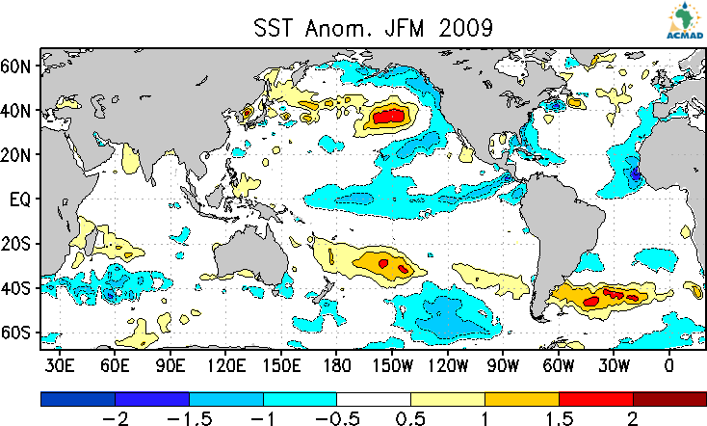
Identical analogue years

Slide 21
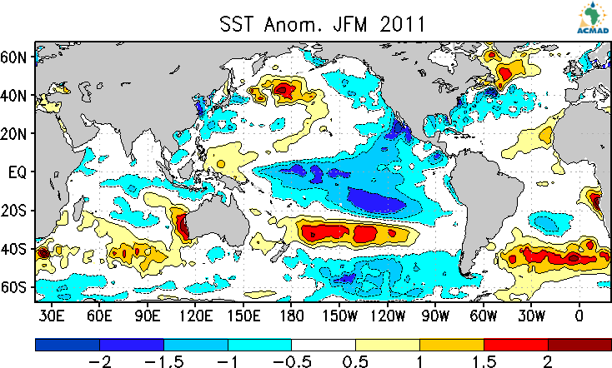
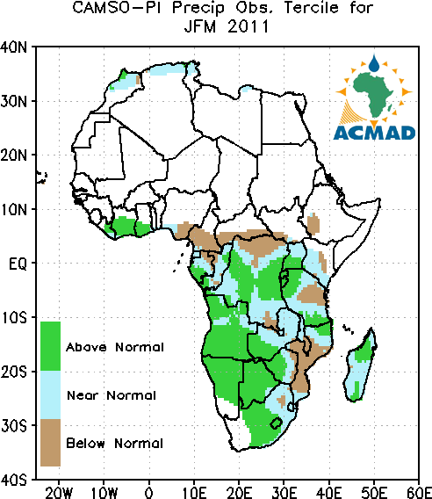
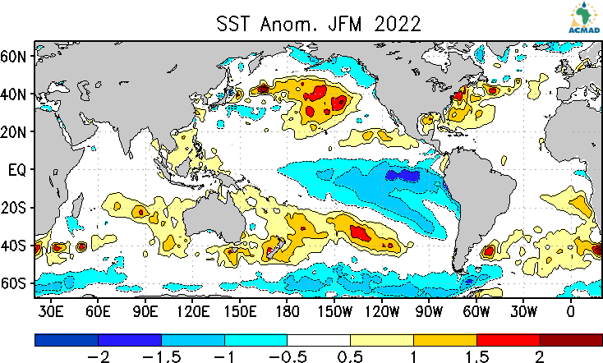
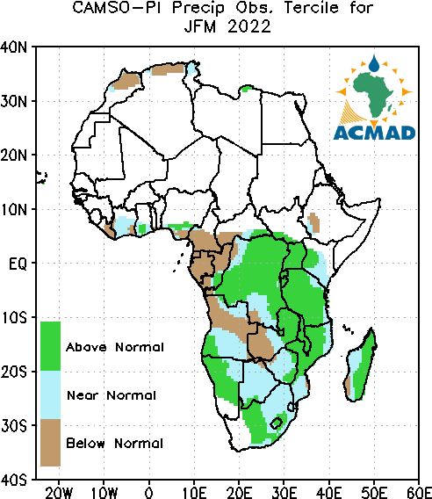
Identical analogue years

